Slide 1
Speech Sentiment and Emotion Detection:
Natural Language Processing
Vaibhav Kabariya
Keyur Desai
Rutu Patel
Elish Patel
Notes:
w

Slide 2

Introduction
Speech Sentiment and Emotion Detection
Objective:
Develop a robust solution to accurately detect and analyze user emotions from speech data.
Enhance understanding between customers/clients interacting online with businesses or organizations via chatbots, etc.

Slide 3
Goals
Accurately detect and analyze emotions behind human conversations captured through spoken language.
Improve interaction experiences for customers/clients engaging with businesses or organizations online

Slide 4
Dataset
CREMA (Crowd Sourced Emotional Multimodal Actors)
Multilingual & Accents
High-Quality Audio
Offers multiple languages and accents, aiding in training models for cross-linguistic and cultural robustness.
Includes background noise mimicking real-world environments.

Slide 5
Dataset
CREMA (Crowd Sourced Emotional Multimodal Actors)
Emotion Annotations
Large Corpus
Expert psychologists annotate emotions like happiness, sadness, etc.
Provides sufficient data for diverse AI applications, preventing overfitting.

Slide 6
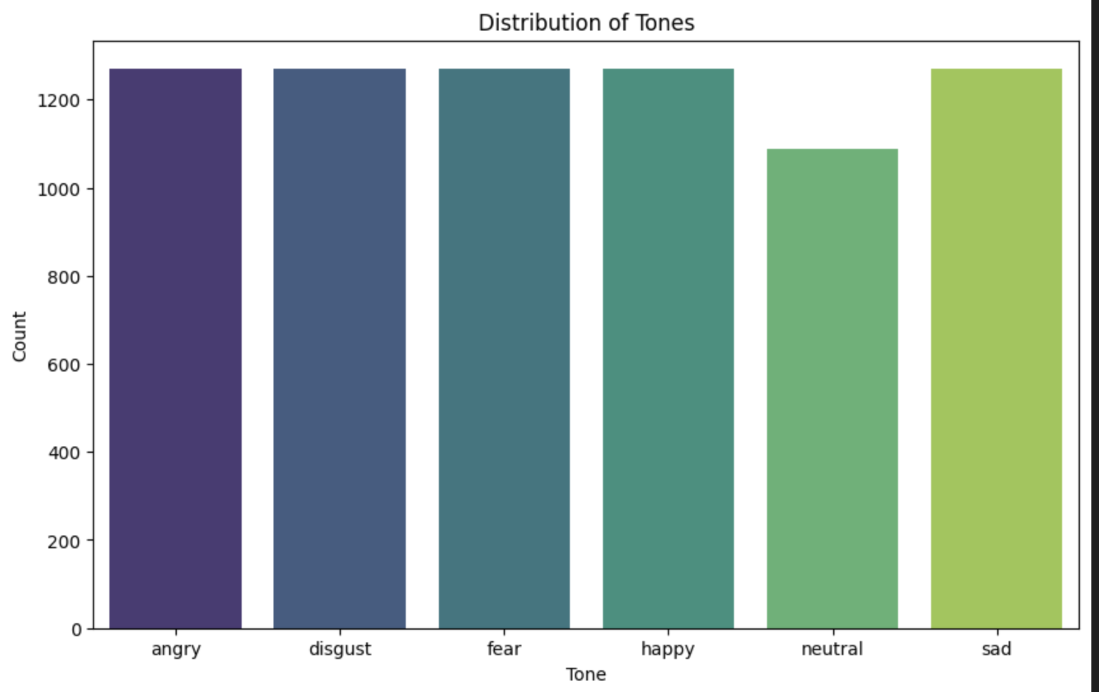
Emotions

Slide 7
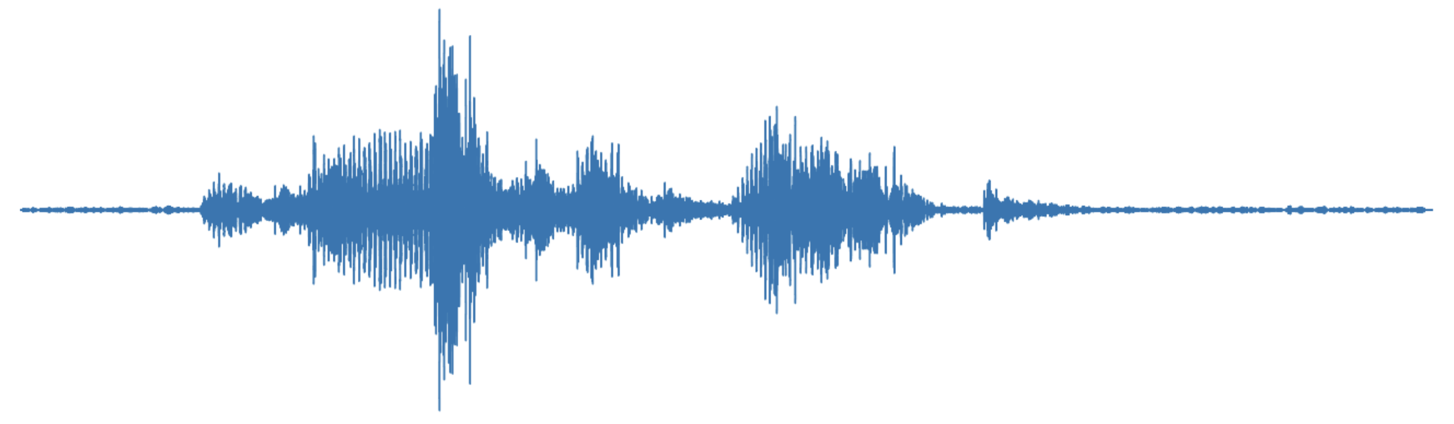
Augmentation
Random Noise Addition
Shifting audio forward or backward
Noise
Audio
Saturn has beautiful rings
Time
Pitch
Stretching the audio signal
Alters the audio signal

Slide 8
Model
Convolutional Neural Network (CNN) for Emotion Detection
Convolutional Layer
Pooling & Dropout Layer
Activation Function

Slide 9
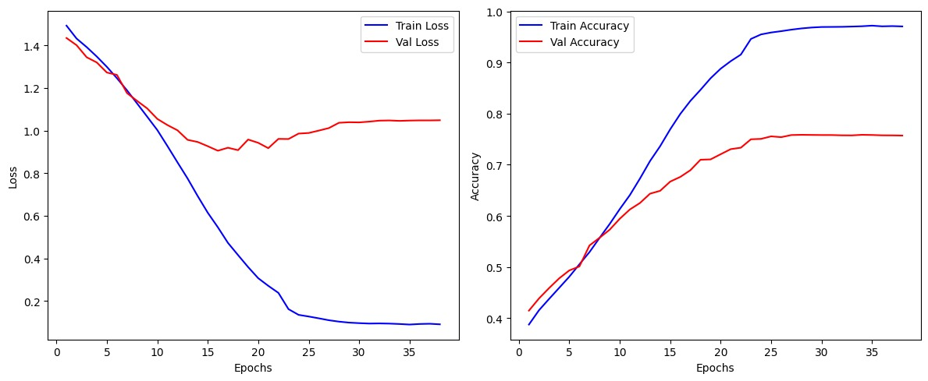
Training and Validation

Slide 10
Conclusion
The proposed solution leverages deep learning models and the CREMA dataset to create an innovative AI system.
Accurately detects sentiments and emotions from speech signals under different conditions.
Handles multiple languages and accent variations effectively for real-world applications requiring emotion recognition capabilities.

Slide 11
Thank You

